Slide 2
Job 1:1 “In the land of Uz there lived a man whose name was Job. This man was blameless and upright; he feared God and shunned evil”

Slide 3
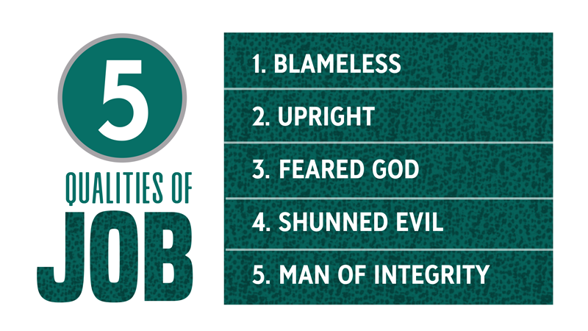

Slide 4
Job 1:2-3 ²He had seven sons and three daughters, ³and he owned seven thousand sheep, three thousand camels, five hundred yoke of oxen and five hundred donkeys, and had a large number of servants. He was the greatest man among all the people of the East.

Slide 5
Job 1:4-5 ⁴His sons used to hold feasts in their homes on their birthdays, and they would invite their three sisters to eat and drink with them. ⁵When a period of feasting had run its course, Job would make arrangements for them to be purified. Early in the morning he would sacrifice a burnt offering for each of them, thinking, “Perhaps my children have sinned and cursed God in their hearts.” This was Job’s regular custom.

Slide 7
Job 1:13-19 ¹³One day when Job’s sons and daughters were feasting and drinking wine at the oldest brother’s house, ¹⁴a messenger came to Job and said, “The oxen were plowing and the donkeys were grazing nearby, ¹⁵and the Sabeans attacked and made off with them. They put the servants to the sword, and I am the only one who has escaped to tell you!” ¹⁶While he was still speaking, another messenger came and said, “The fire of God fell from the heavens and burned up the sheep and the servants, and I am the only one who has escaped to tell you!”
¹⁷While he was still speaking, another messenger came and said, “The Chaldeans formed three raiding parties and swept down on your camels and made off with them. They put the servants to the sword, and I am the only one who has escaped to tell you!” ¹⁸While he was still speaking, yet another messenger came and said, “Your sons and daughters were feasting and drinking wine at the oldest brother’s house, ¹⁹when suddenly a mighty wind swept in from the desert and struck the four corners of the house. It collapsed on them and they are dead, and I am the only one who has escaped to tell you!”

Slide 8
Job 1:6-8 ⁶One day the angels came to present themselves before the Lord, and Satan also came with them. ⁷The Lord said to Satan, “Where have you come from?” Satan answered the Lord, “From roaming throughout the earth, going back and forth on it.” ⁸Then the Lord said to Satan, “Have you considered my servant Job? There is no one on earth like him; he is blameless and upright, a man who fears God and shuns evil.”

Slide 9
Job 1:9-12 ⁹“Does Job fear God for nothing?” Satan replied. ¹⁰“Have you not put a hedge around him and his household and everything he has? You have blessed the work of his hands, so that his flocks and herds are spread throughout the land.

Slide 10
Job 1:11 But now stretch out your hand and strike everything he has, and he will surely curse you to your face.
Job 1:12 The Lord said to Satan, “Very well, then, everything he has is in your power, but on the man himself do not lay a finger.”

Slide 11
Job 1:20-22 “²⁰ At this, Job got up and tore his robe and shaved his head. Then he fell to the ground in worship ²¹ and said:
“Naked I came from my mother’s womb, and naked I will depart.^{[c]} The Lord gave and the Lord has taken away; may the name of the Lord be praised.”
²² In all this, Job did not sin by charging God with wrongdoing.”

Slide 12
Job 2:1-3 ¹On another day the angels came to present themselves before the Lord, and Satan also came with them to present himself before him. ²And the Lord said to Satan, “Where have you come from?” Satan answered the Lord, “From roaming throughout the earth, going back and forth on it.” ³Then the Lord said to Satan, “Have you considered my servant Job? There is no one on earth like him; he is blameless and upright, a man who fears God and shuns evil. And he still maintains his integrity, though you incited me against him to ruin him without any reason.”

Slide 13
Job 2:4-5 “Skin for skin!” Satan replied. “A man will give all he has for his own life. But now stretch out your hand and strike his flesh and bones, and he will surely curse you to your face.”
Job 2:6 The Lord said to Satan, “Very well, then, he is in your hands; but you must spare his life.”

Slide 14
Job 2:7-8 ⁷So Satan went out from the presence of the Lord and afflicted Job with painful sores from the soles of his feet to the crown of his head. ⁸Then Job took a piece of broken pottery and scraped himself with it as he sat among the ashes.
Job 7:5 ”My body is clothed with worms and scabs, my skin is broken and festering.”

Slide 15
Job 2:9 His wife said to him, “Are you still maintaining your integrity? Curse God and die!”
Job 2:10 He replied, “You are talking like a foolish woman. Shall we accept good from God, and not trouble?”

Slide 16
Here is the key phrase to the victory: Job says to her:
Job 2:10b “Shall we accept good from God, and not trouble?”

Slide 17
Job 1:12 The Lord said to Satan, “Very well, then, everything he has is in your power, but on the man himself do not lay a finger.”
Job 2:6 The Lord said to Satan, “Very well, then, he is in your hands; but you must spare his life.”

Slide 18
You don’t have to be afraid of Satan, you need to fear God.
Job 1:22 In all this, Job did not sin by charging God with wrongdoing.

Slide 19
Amos 3:6 When disaster comes to a city, has not the Lord caused it?
Our God is sovereign, and he has dominion over what Satan can do. Don’t be afraid of the devil. God reigns in the holiness of Job.

Slide 20
God is sovereign over your life. Acknowledge that in your tragedies and sufferings.
Psalm 115:3 Our God is in heaven; he does whatever pleases him.
Daniel 4:35 He does as he pleases with the powers of heaven and the peoples of the earth. No one can hold back his hand or say to him: “What have you done?”

