Slide 1
Trinity Lutheran Church
June 12, 2016
Guidelines for Godly Managing
The Real Treasure
Philippians 4:8-20
Pastor Bruce Rumsch,
Minister of Worship & Spiritual Care

Slide 2
“X” Marks the Spot

Slide 3
The right frame of mind (vs.8,9)

Slide 4
Learning the secret (vs.10-13)

Slide 5
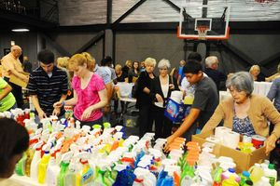
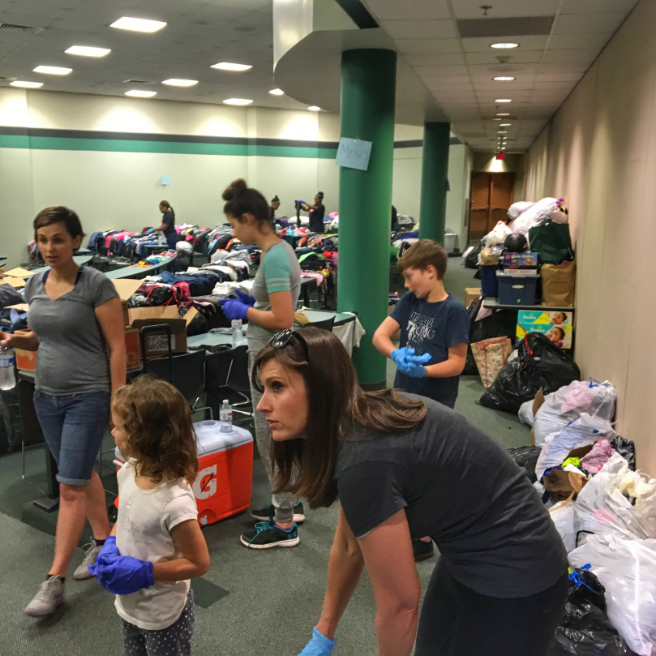
Partnership (vs.14-18)

Slide 6
God supplies, praise God! (vs.19,20)

Slide 7
Guidelines for Godly Managing
#1 - Ownership and cheerfulness
#2 - The Jesus Example
#3 - The real treasure – God will provide

