Slide 1
“The New You”
Part 2
Trinity Lutheran Church
August 28, 2016
Colossians 3:12-17
Pastor Bruce Rumsch
Minister of Worship & Spiritual Care

Slide 2
A Note from Paul … “The New You (Pt.2)”

Slide 3
New model or new creation?

Slide 4
“Put to death …” (vs.5-9)

Slide 5
The “new self” (vs.1,3,10)

Slide 6
“Put on …” (vs.12-16)

Slide 7
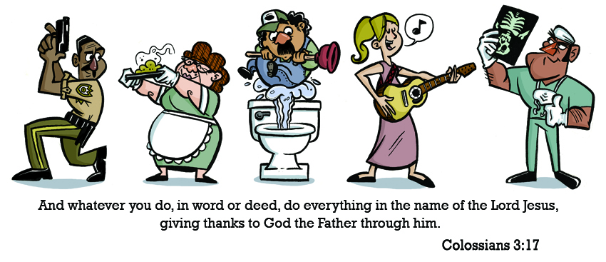
“And whatever you do…” (vs.17)

Slide 8
Way of life and new life!

