Slide 1
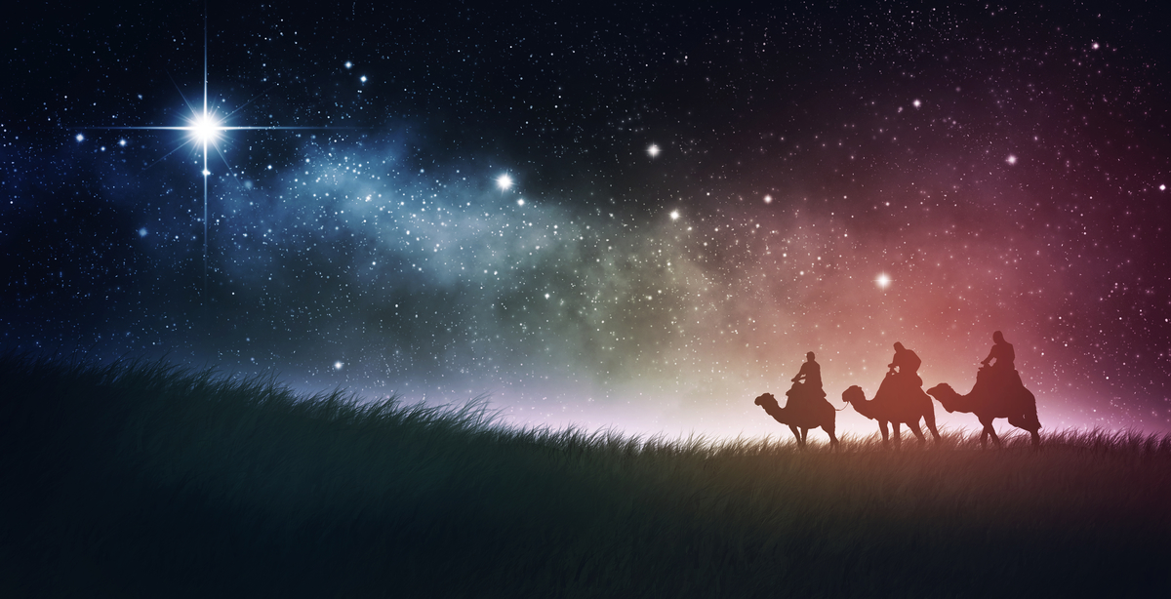
Revealing the REAL Jesus
An Epiphany Journey

Slide 2
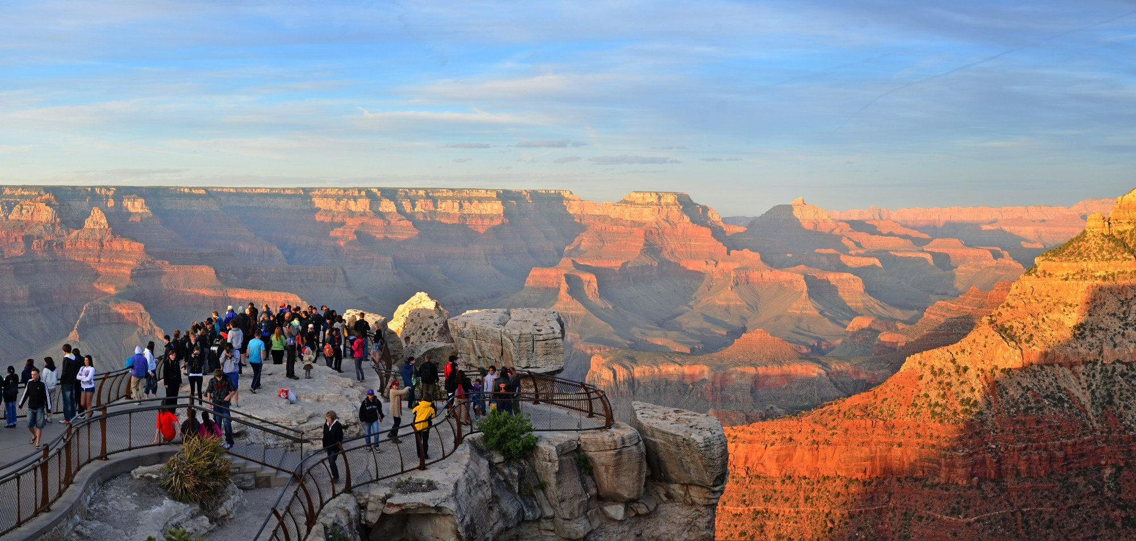
“…from where I’m at…”

Slide 3
For Moses and Elijah

Slide 4
For Peter, James, and John

Slide 5
For Jesus

Slide 6
From where we are looking?

Slide 7
The view from the top!

