Slide 2
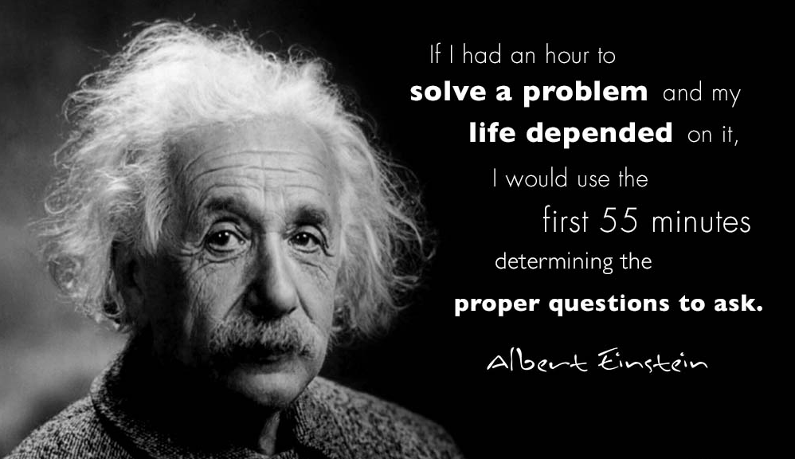
The right question

Slide 3
A SIMPLE REQUEST

Slide 4
THAT’S NOT SO SIMPLE

Slide 5
BROKEN COMMUNITY

Slide 6
Rebuilding community

Slide 7
“… a ransom for many”

